Slide 1
NYC Electricity Consumption Predictability
Time Series Forecasting using Facebook Prophet
Muhammad Ehtesham

Slide 2
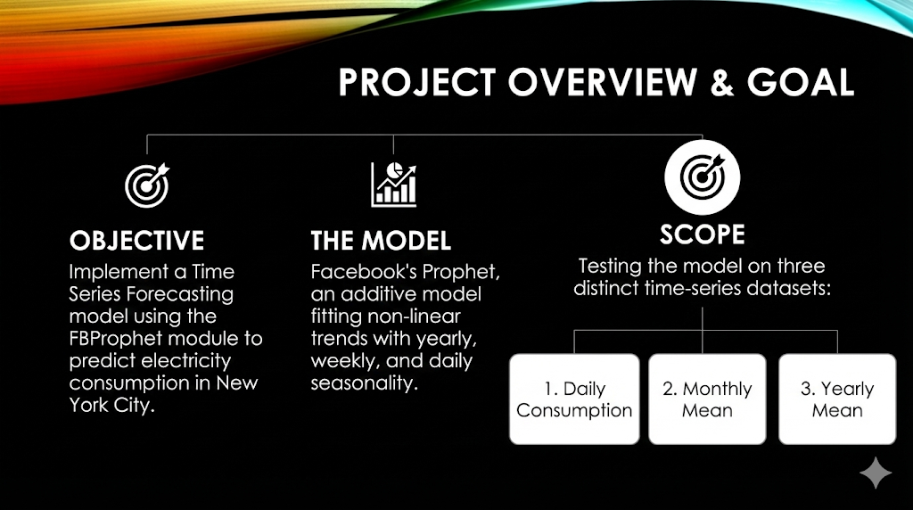
Project Overview & Goal
Objective: Implement a Time Series Forecasting model using the FBProphet module to predict electricity consumption in New York City.
The Model: Facebook’s Prophet, an additive model fitting non-linear trends with yearly, weekly, and daily seasonality.
Scope: Testing the model on three distinct time-series datasets:
Daily Consumption.
Monthly Mean.
Yearly Mean.

Slide 3
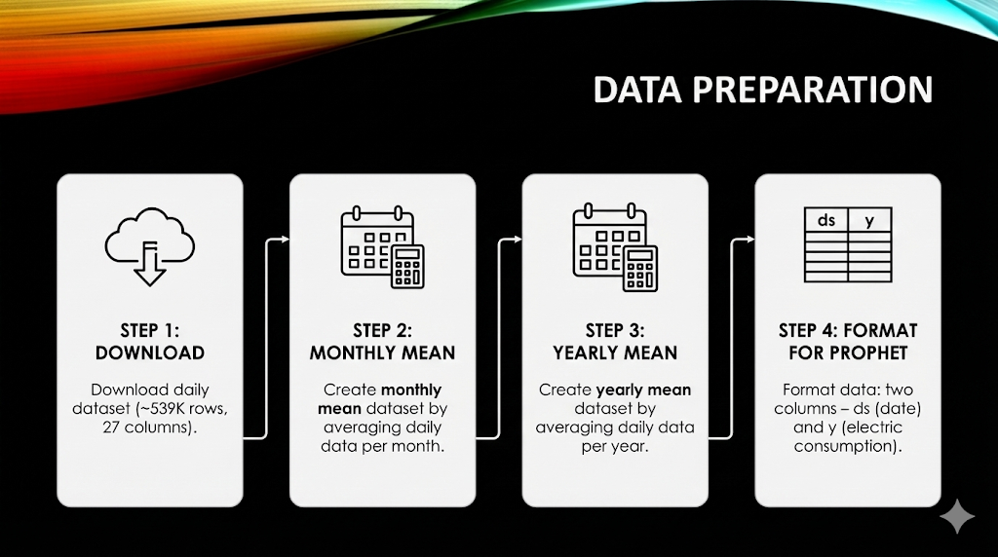
Data Preparation
Steps:
Download daily dataset (~539K rows, 27 columns).
Create monthly mean dataset by averaging daily data per month.
Create yearly mean dataset by averaging daily data per year.
Format data for Prophet: two columns – ds (date) and y (electric consumption).

Slide 4
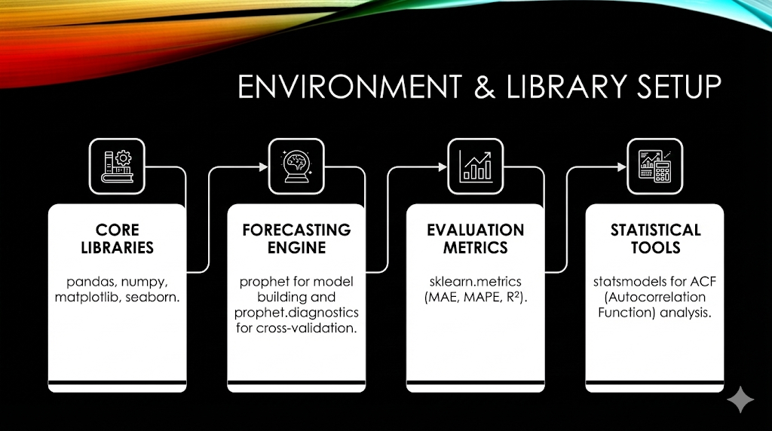
Environment & Library Setup
Core Libraries: pandas, numpy, matplotlib, seaborn.
Forecasting Engine: prophet for model building and prophet.diagnostics for cross-validation.
Evaluation Metrics: sklearn.metrics (MAE, MAPE, R²).
Statistical Tools: statsmodels for ACF (Autocorrelation Function) analysis.

Slide 5
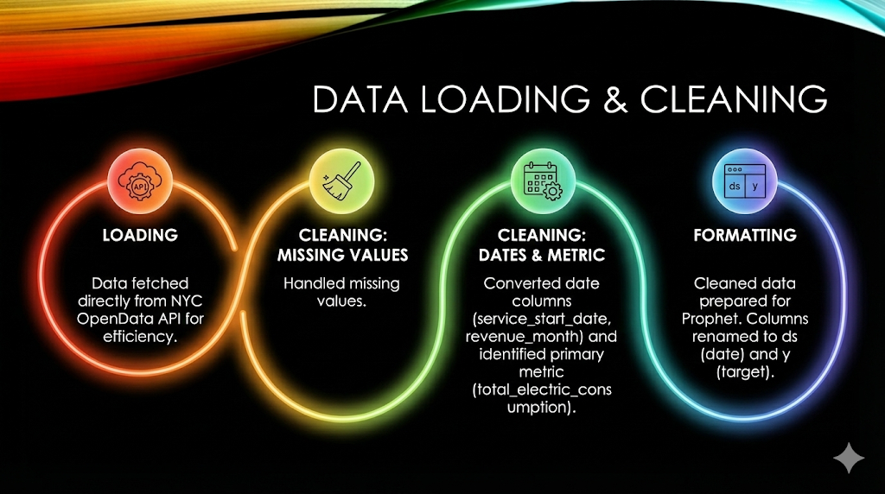
Data Loading & Cleaning
Loading: Data fetched directly from NYC OpenData API for efficiency.
Data Cleaning:
Handled missing values.
Converted date columns (service_start_date, revenue_month) to datetime objects.
Identified the primary metric: total_electric_consumption.
Formatting: Cleaned data prepared in the required Prophet format (columns renamed to ds for date and y for target).

Slide 6
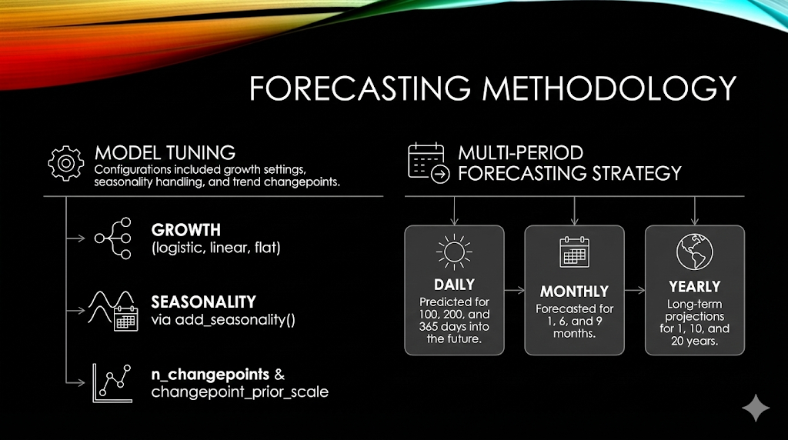
Forecasting Methodology
Model Tuning:
  Configurations included growth settings, seasonality handling, and trend changepoints.
  growth (logistic, linear, flat)
Seasonality via add_seasonality()
n_changepoints & changepoint_prior_scale
Multi-Period Forecasting Strategy:
Daily: Predicted for 100, 200, and 365 days into the future.
Monthly: Forecasted for 1, 6, and 9 months.
Yearly: Long-term projections for 1, 10, and 20 years.

Slide 7
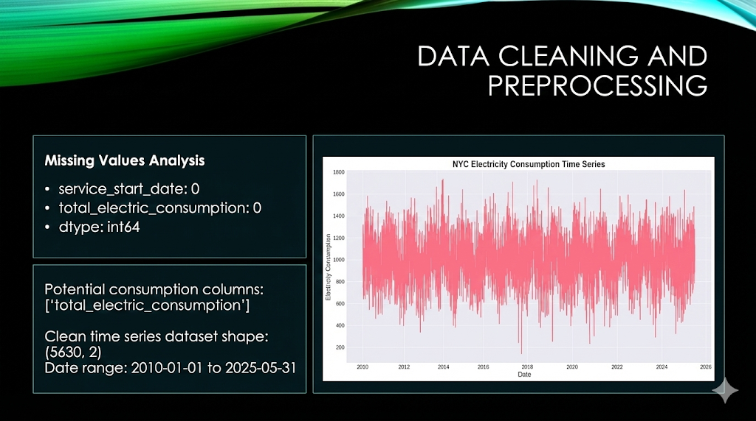
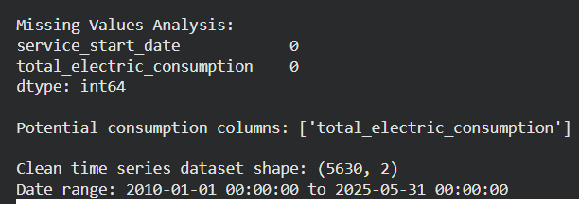
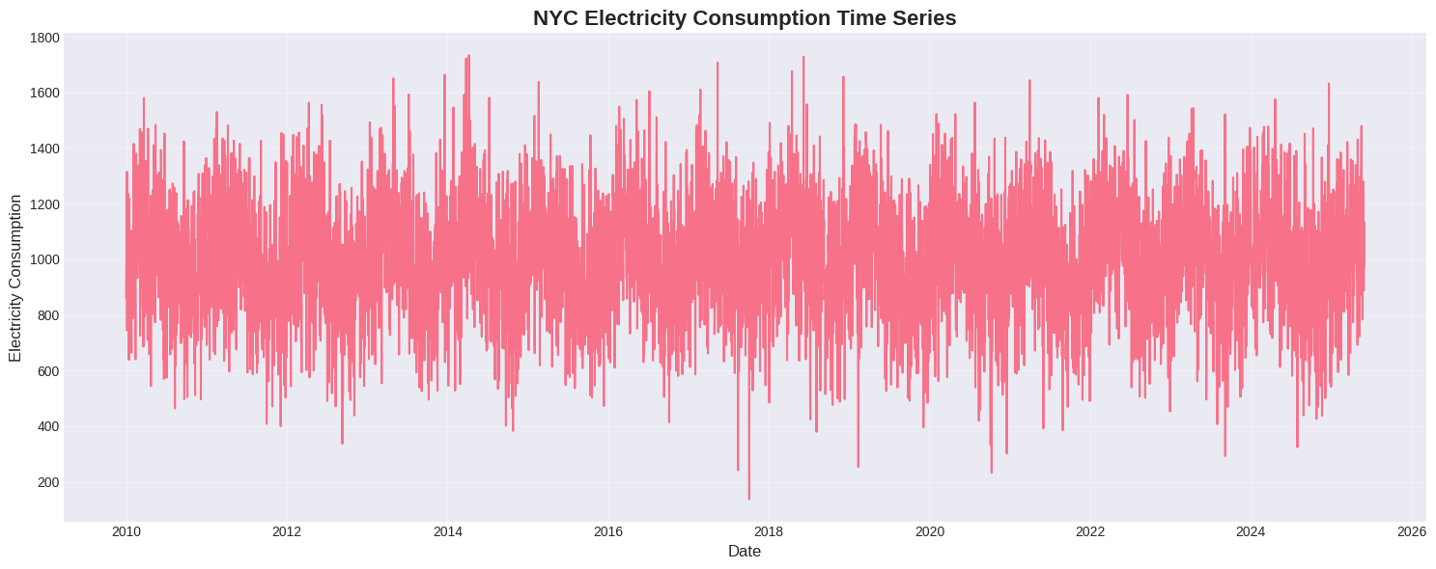
Data Cleaning and Preprocessing

Slide 8
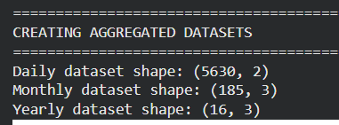
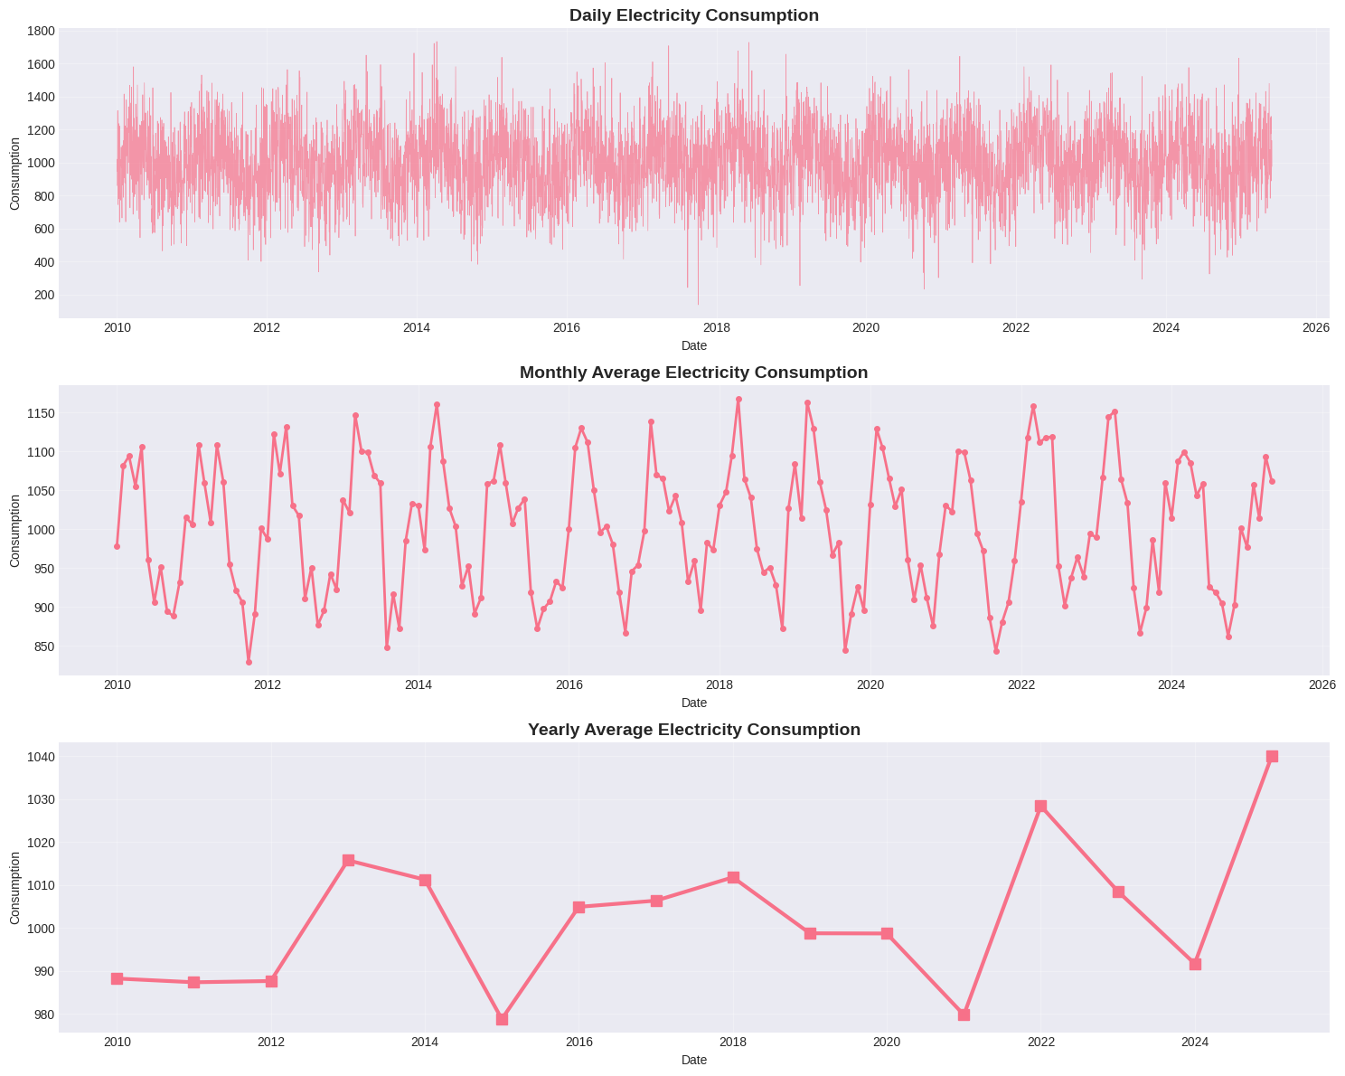
CREATING AGGREGATED DATASETS

Slide 9
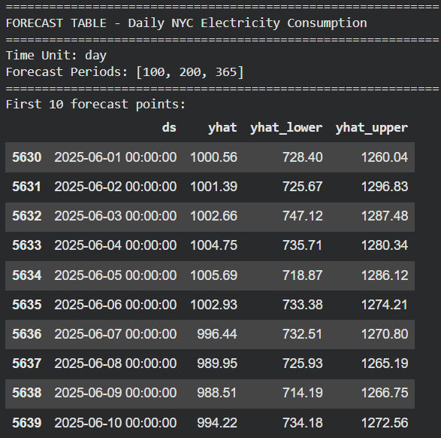
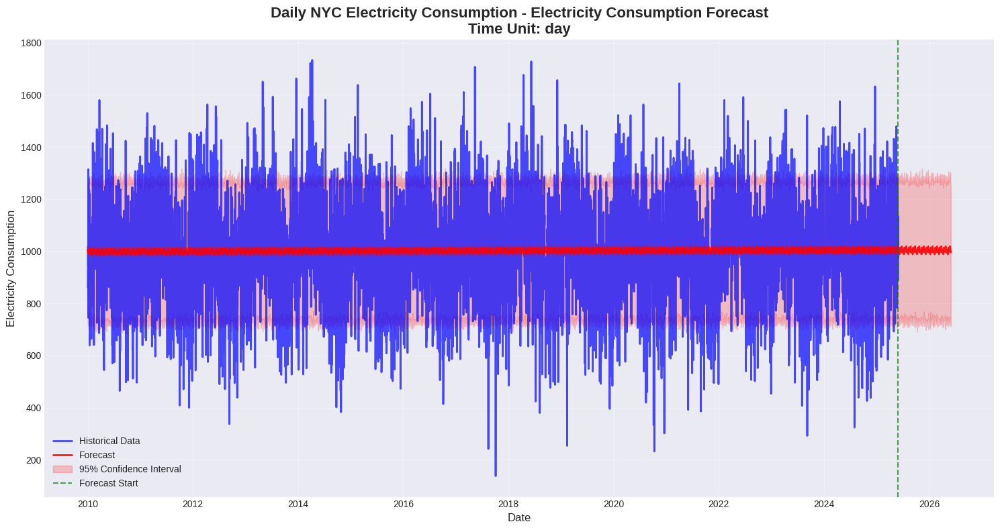
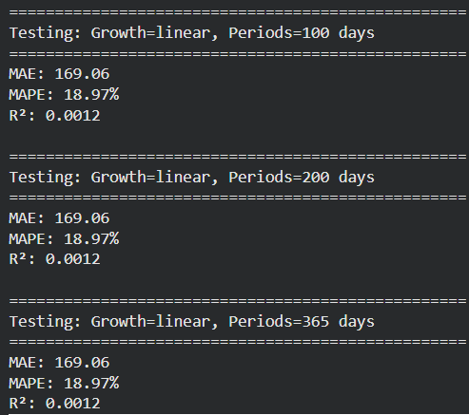
Daily Data Forecasting

Slide 10
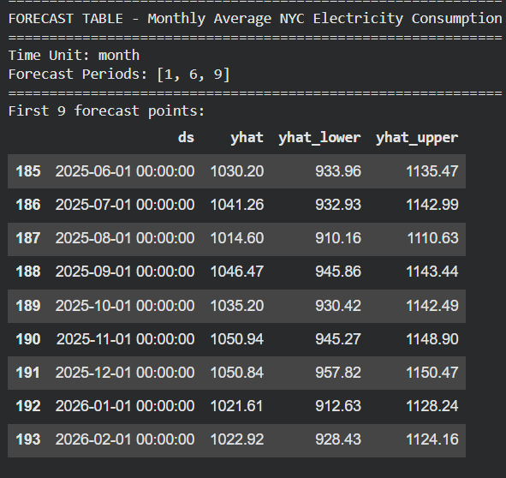
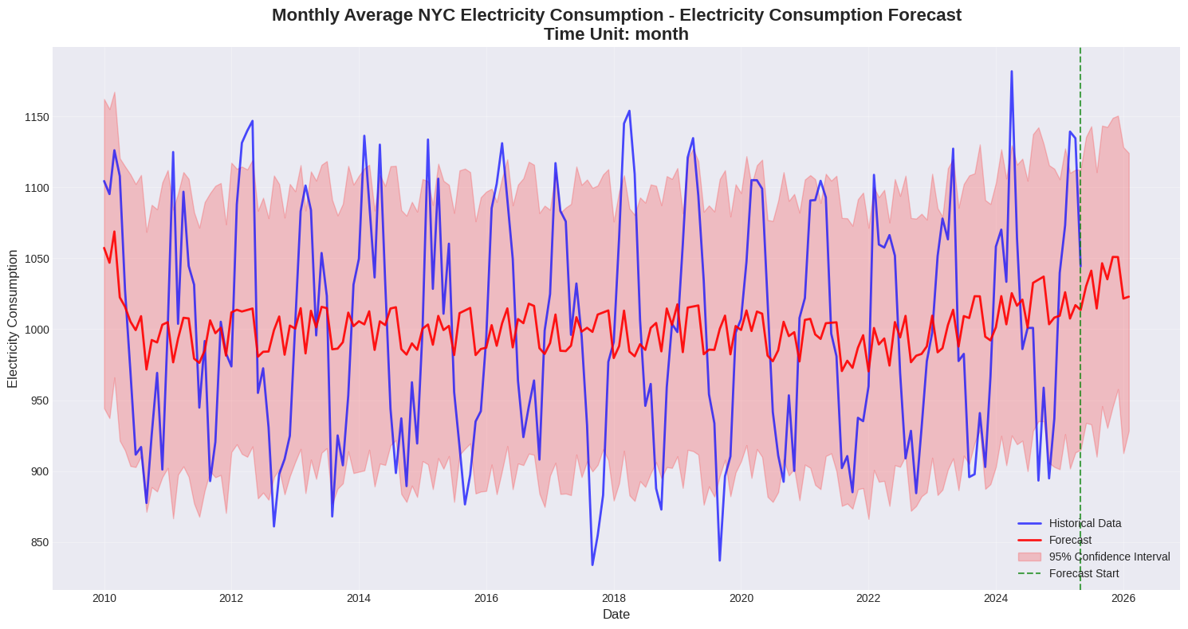
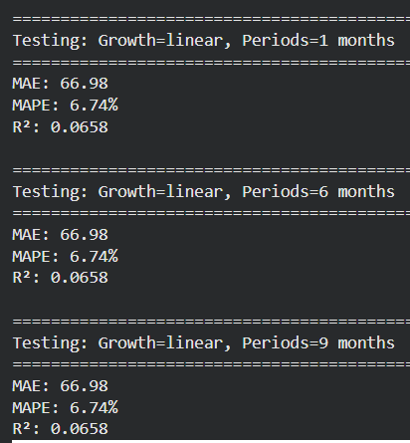
Monthly Data Forecasting

Slide 11
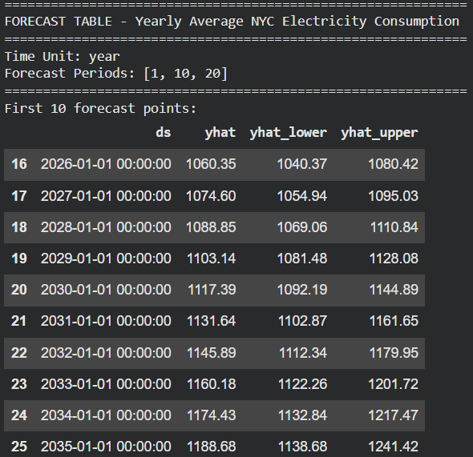
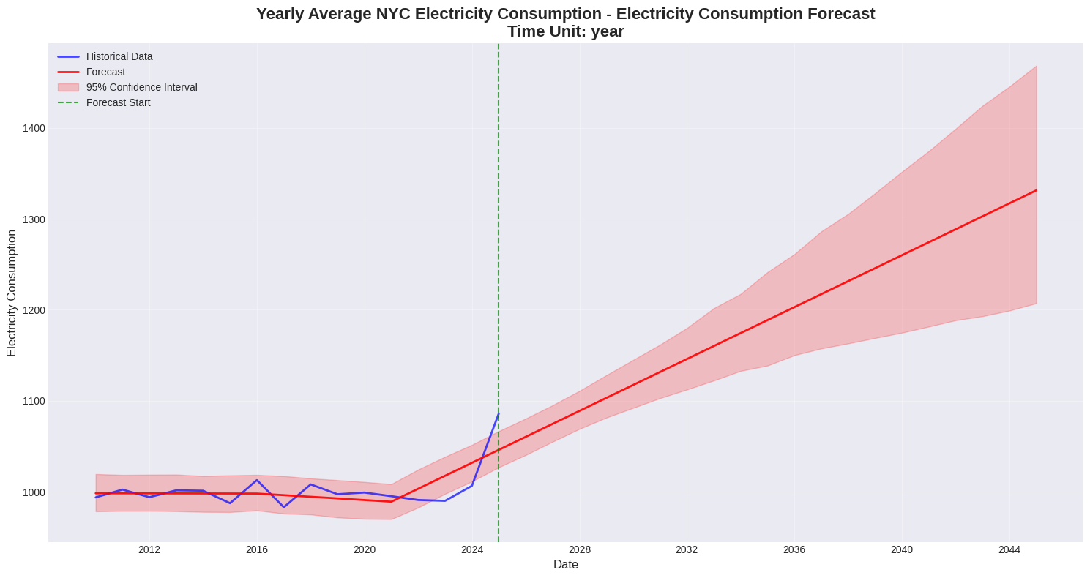
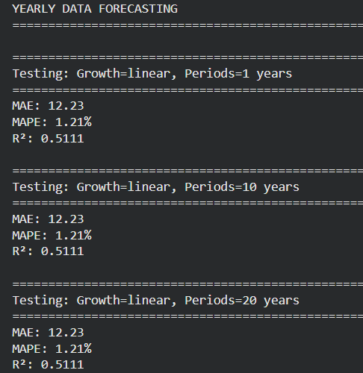
Yearly Average NYC Electricity Consumption

Slide 12
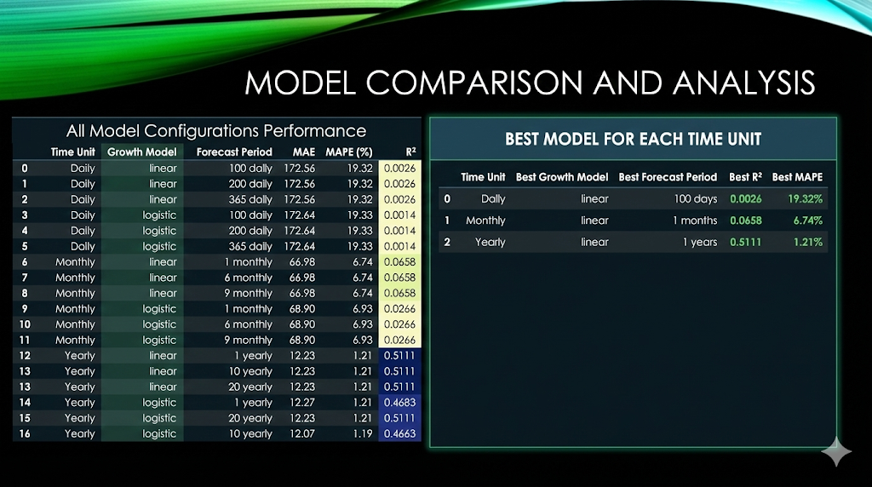
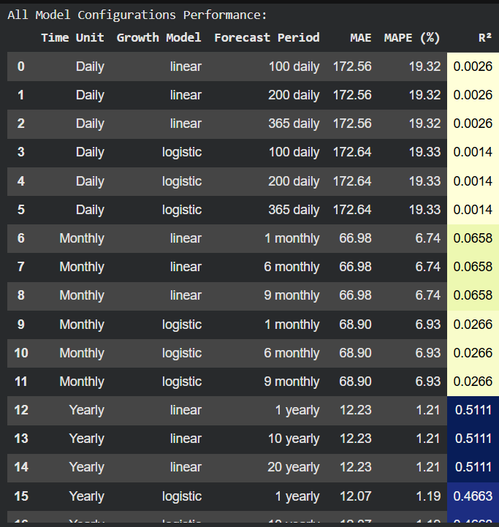
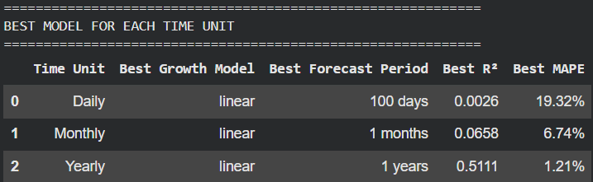
Model Comparison and Analysis

Slide 13
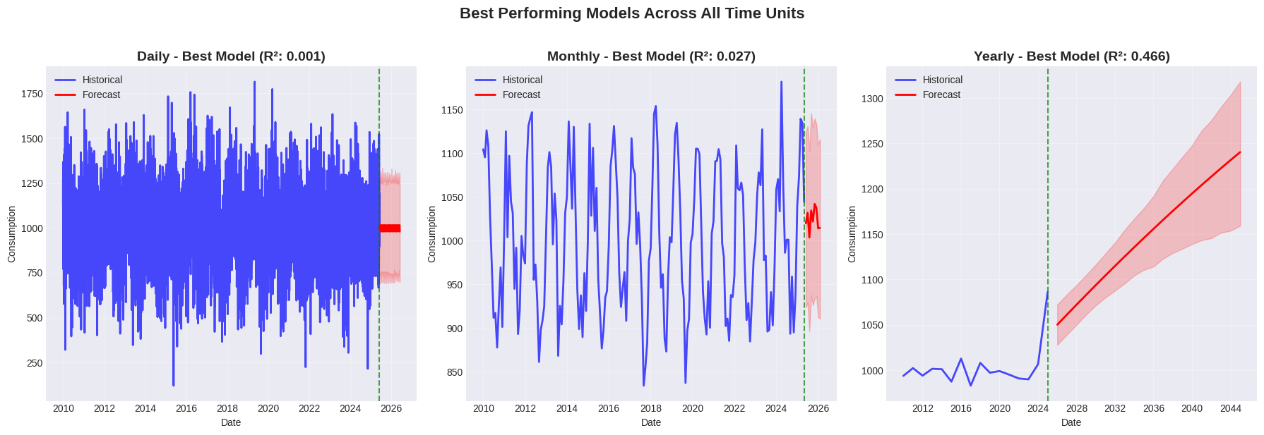

Slide 14
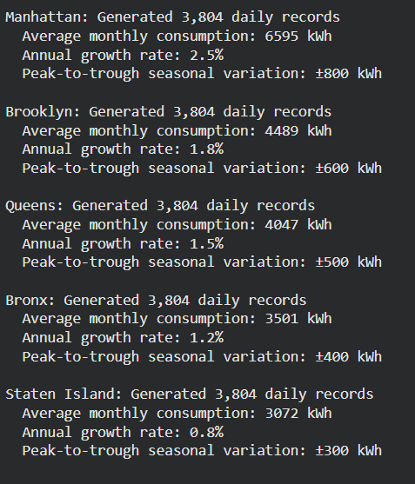
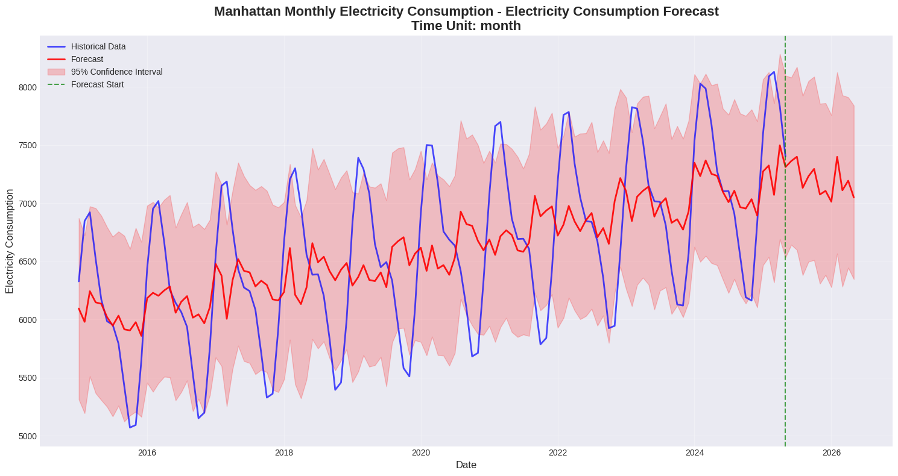
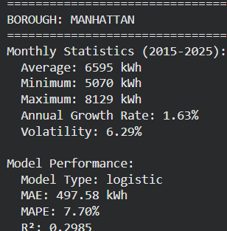
Extra Credit - Realistic Borough-wise Analysis

Slide 15
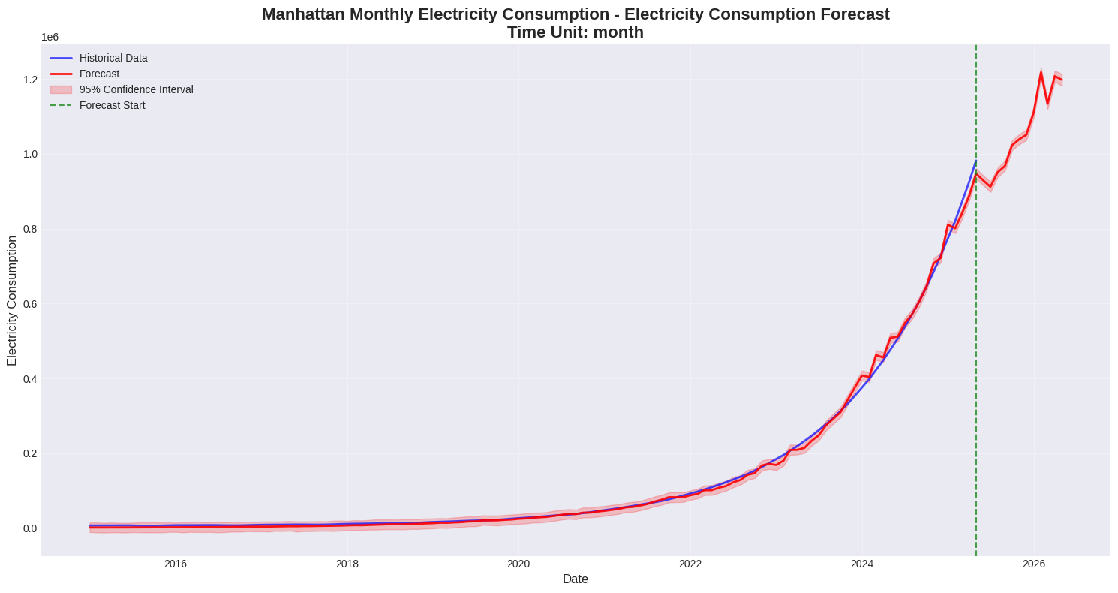

Slide 16
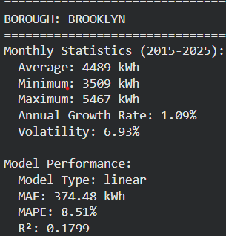
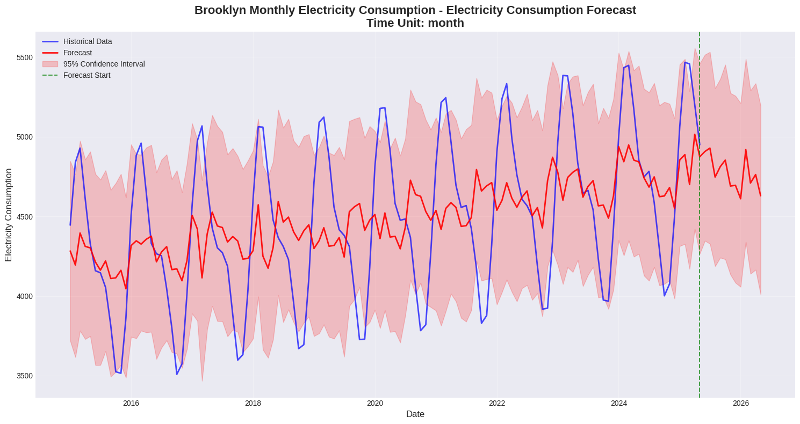
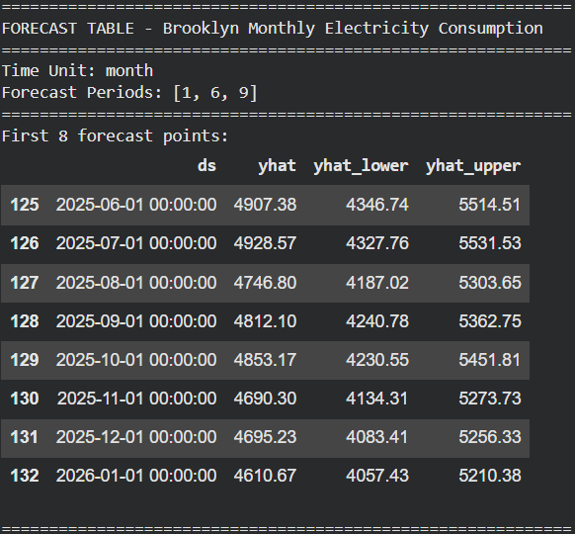
Borough-wise Analysis

Slide 17
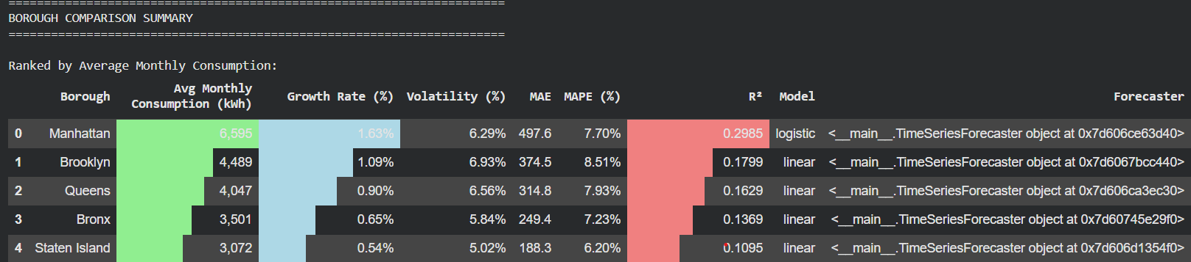
BOROUGH COMPARISON SUMMARY

Slide 18
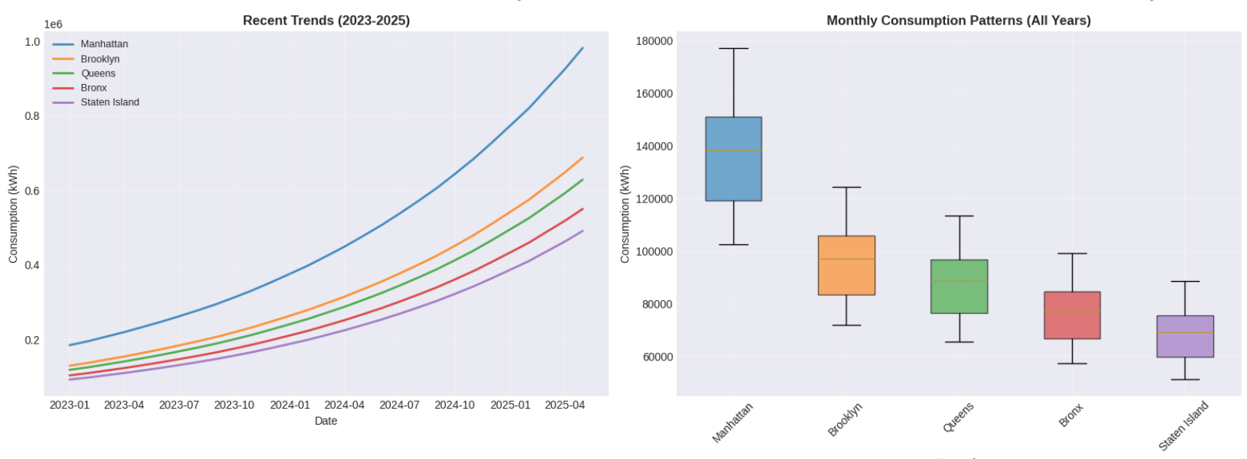
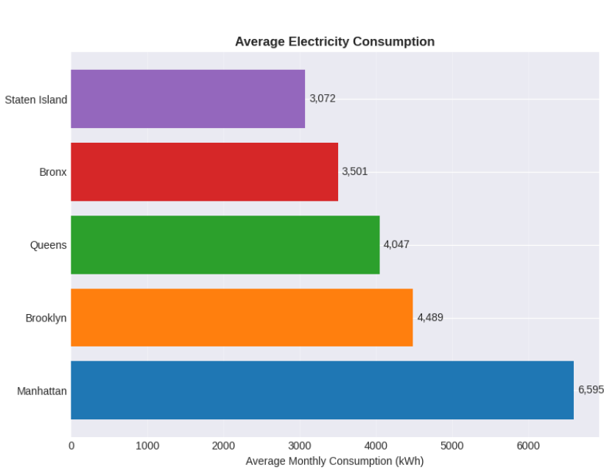

Slide 19
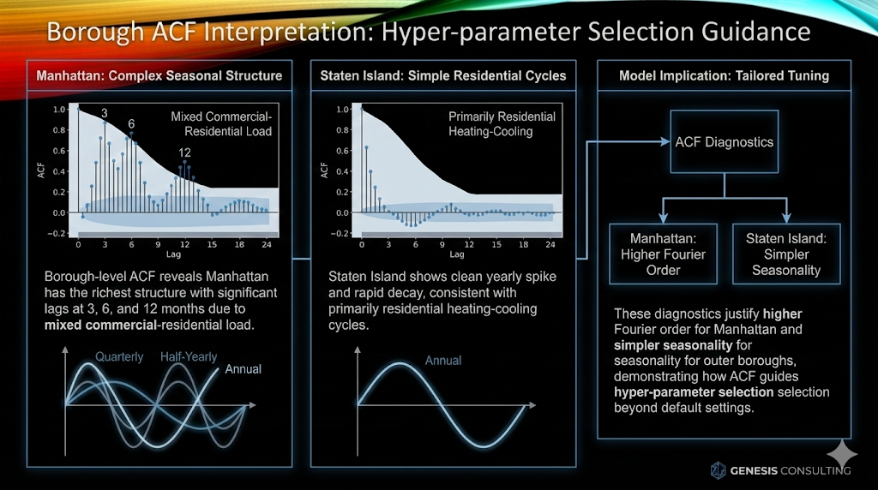
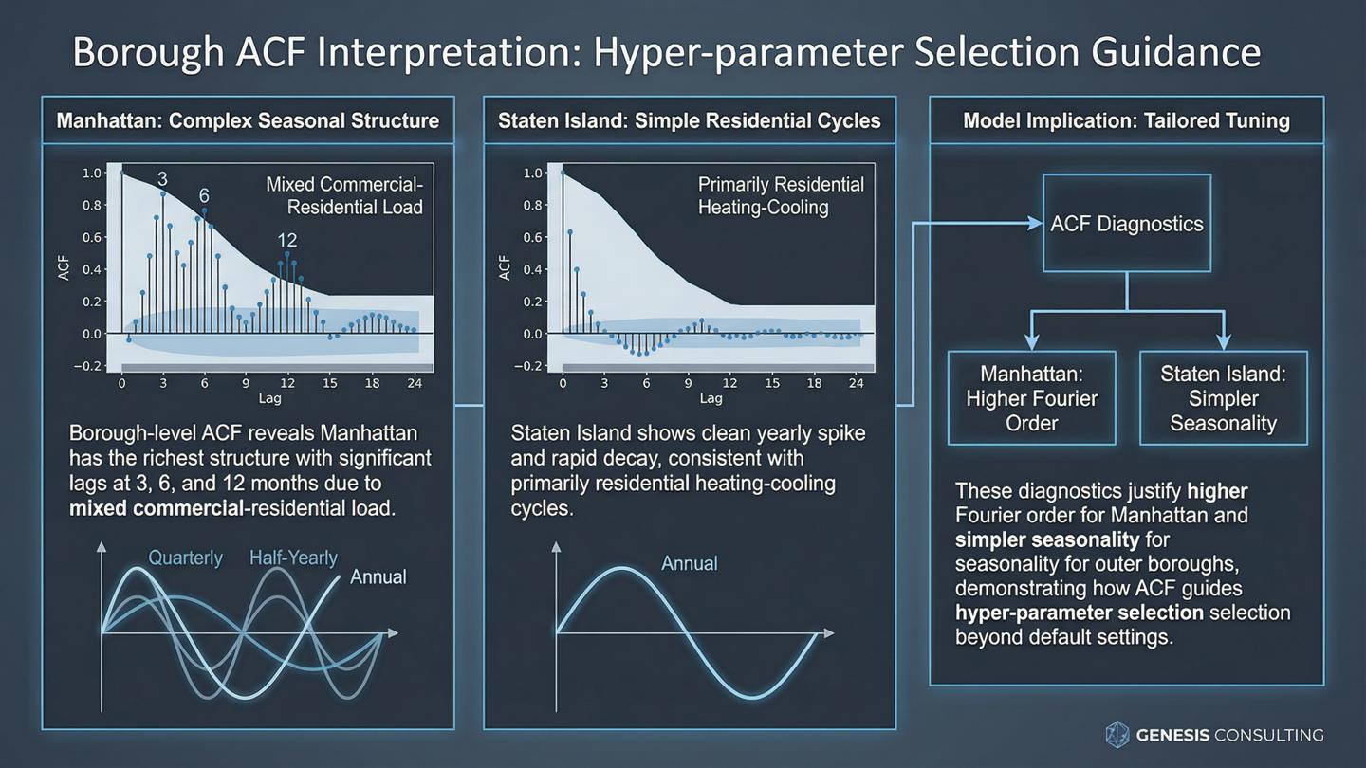

Slide 20
